Slide 1


MTH 480 – Deep Learning
Dr. Jeff Baggett
1. Introduction
These slides are adapted from “Understanding Deep Learning” by Simon J.D. Prince. The original slides and other materials may be found here: https://udlbook.github.io/udlbook/

Slide 2
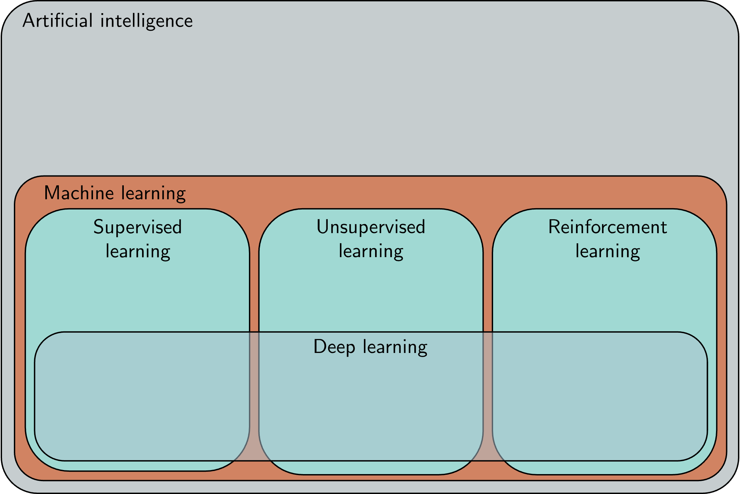
Semester 1

Slide 3
Logistics
2 classes per week (85 minutes each)
Each class is a combination of lecture and lab
Bring laptop if you can (nothing fancy, just need a browser)
Coursework
Frequent problem sets (usually Jupyter notebooks) and 2 projects
Most work will be completed in Google Colab
You’ll need a Google account (may be able to use UWL email …)
Slides, notes, and other resources in Canvas (let’s have a look)
Ask questions on Piazza (see Canvas), in class, or in office hours

Slide 4
Landmarks in AI
2012 AlexNet (Image classification)
2014 Generative adversarial networks (Image generation)
2016 AlphaGo
2017 Machine translation
2019- Language models (Bert, GPT3)
2022 Dall-E2 (Image synthesis from text prompts)

Slide 5
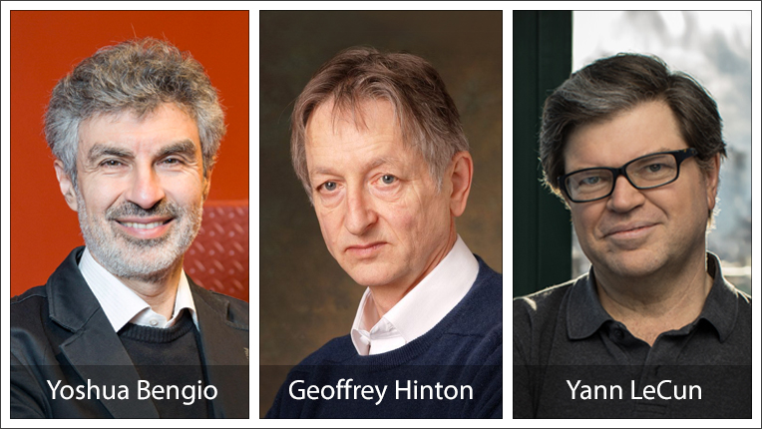
2018 Turing award winners
Watch interviews with these pioneers on Youtube (about 6 minutes)

Slide 6
Deep Learning
Supervised learning
Given dataset of (input,output) pairs, learn patterns so new outputs can be generated for new inputs
Unsupervised learning
Generative models – learn patterns and produce new examples (GANS)
Autoencoders – learn patterns to reduce dimensionality of data
Clustering – grouping similar data together
Reinforcement learning
An agent learns to make decisions to achieve some goal

Slide 7
Supervised learning
Define a mapping from input to output
Learn this mapping from paired input/output data examples

Slide 8
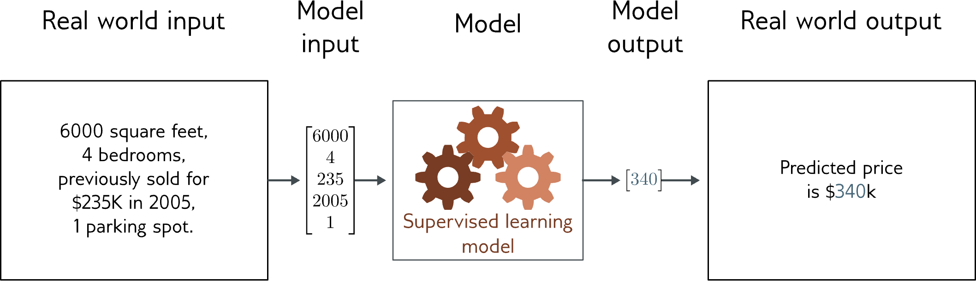
Regression
Univariate regression problem (one output, real value)
Fully connected network

Slide 9
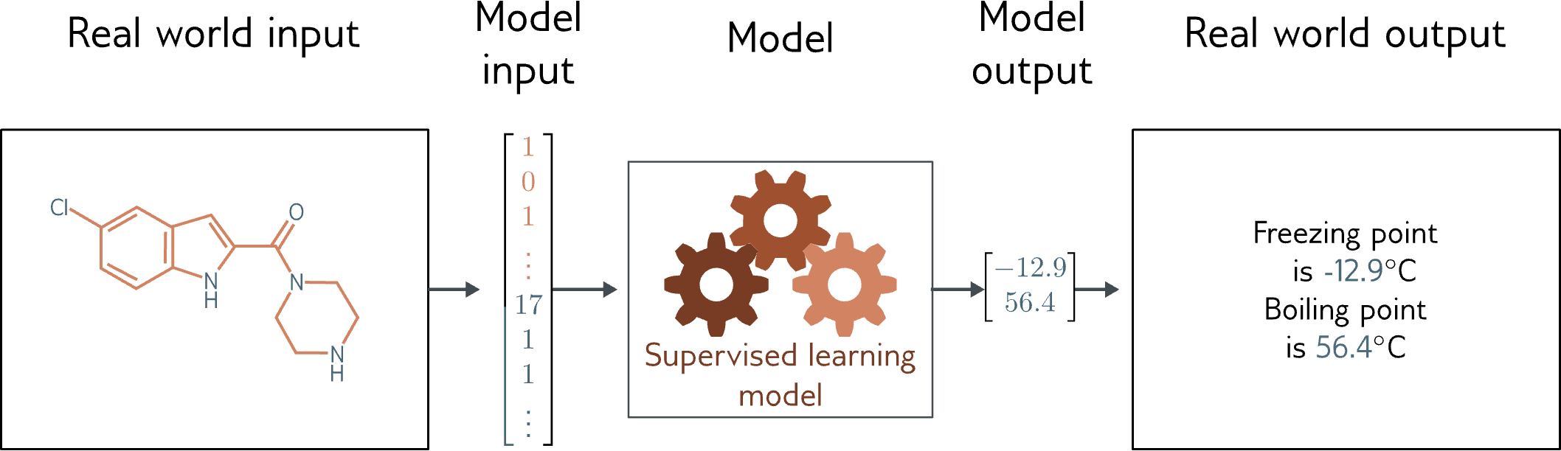
Graph regression
Multivariate regression problem (>1 output, real value)
Graph neural network

Slide 10
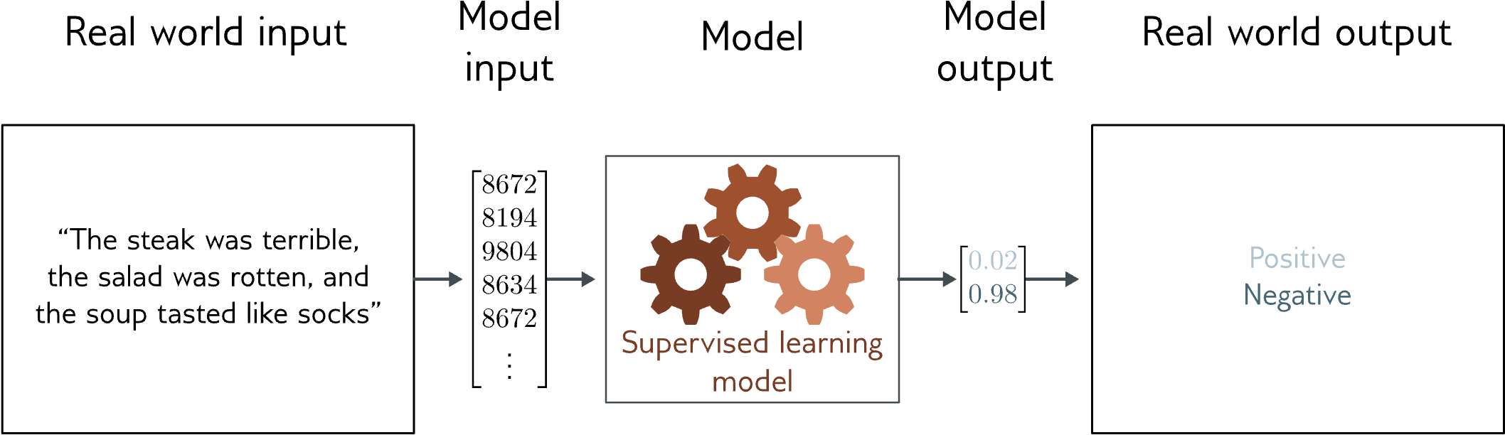
Text classification
Binary classification problem (two discrete classes)
Transformer network

Slide 11
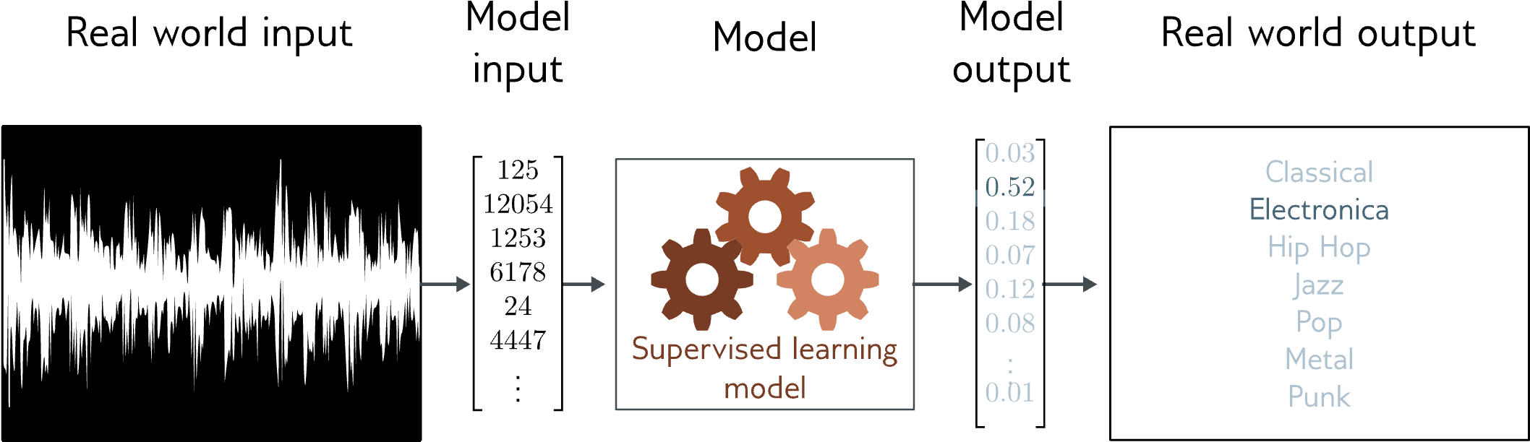
Music genre classification
Multiclass classification problem (discrete classes, >2 possible values)
Convolutional network

Slide 12
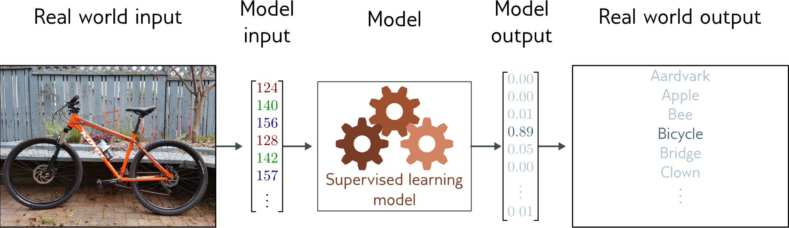
Image classification
Multiclass classification problem (discrete classes, >2 possible classes)
Convolutional network

Slide 13
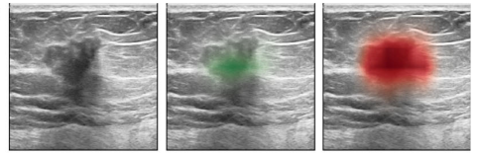
My research interests:
Diagnosing breast cancer in ultrasound images
Video demonstrating Beamworks realtime lesion detection
Video about AI in Radiology at Stanford.

Slide 14
What is a supervised learning model?
An equation relating input (age) to output (height)
Search through family of possible equations to find one that fits training data well

Slide 15
What is a supervised learning model?
Deep neural networks are just a very flexible family of equations
Fitting deep neural networks = “Deep Learning”

Slide 16
Image segmentation
Multivariate binary classification problem (many outputs, two discrete classes)
Convolutional encoder-decoder network

Slide 17
Entity classification
Multivariate multiclass classification
Transformer network

Slide 18
Depth estimation
Multivariate regression problem (many outputs, continuous)
Convolutional encoder-decoder network

Slide 19
Pose estimation
Multivariate regression problem (many outputs, continuous)
Convolutional encoder-decoder network

Slide 20
Terms
Classification = discrete classes as output
Regression = continuous numbers as output
Two class and multiclass classification treated differently
Univariate = one output
Multivariate = more than one output

Slide 21
Translation

Slide 22
Image captioning

Slide 23
Image generation from text

Slide 24
What do these examples have in common?
Very complex relationship between input and output
Sometimes may be many possible valid answers
But outputs (and sometimes inputs) obey rules
Language obeys grammatical rules
Natural images also have “rules”

Slide 25
Idea
Learn the “grammar” of the data from unlabeled examples
Can use a gargantuan amount of data to do this (as unlabeled)
Training text and image generation models is a two stage process:
1. Unsupervised pre-training (e.g. hide parts of the data and ask the model to predict them).
2. Supervised fine-tuning. The pretrained model is trained on a smaller dataset with labels.

